Slide 1
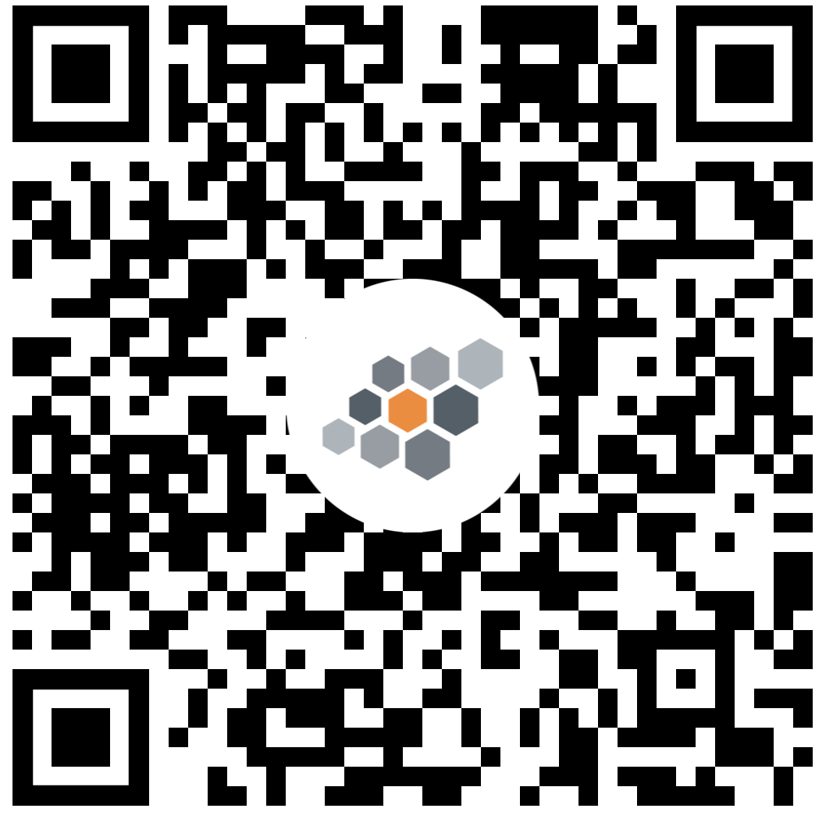


App Paper Prototyping Kit
Dieses Kit ist Open-Source. Informationen unter:
https://github.com/ScaleIT-Org/workshop-app-prototyping
© KIT 2017, MIT Lizenz
Andrei Miclaus, andrei.miclaus@kit.edu
Laura Halbmann, halbmann@teco.edu

Slide 2

https://www.westfield.in.gov/egov/apps/action/center.egov?view=form;page=1;id=404

Slide 3
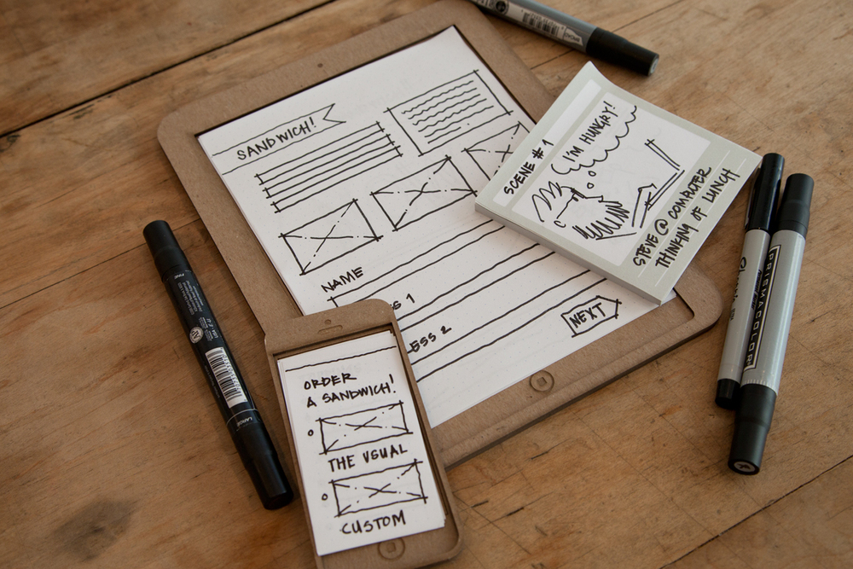
http://juliebestry.com/2013/10/11/tech-planning-on-paper-from-old-fashioned-to-cutting-edge/

Slide 4
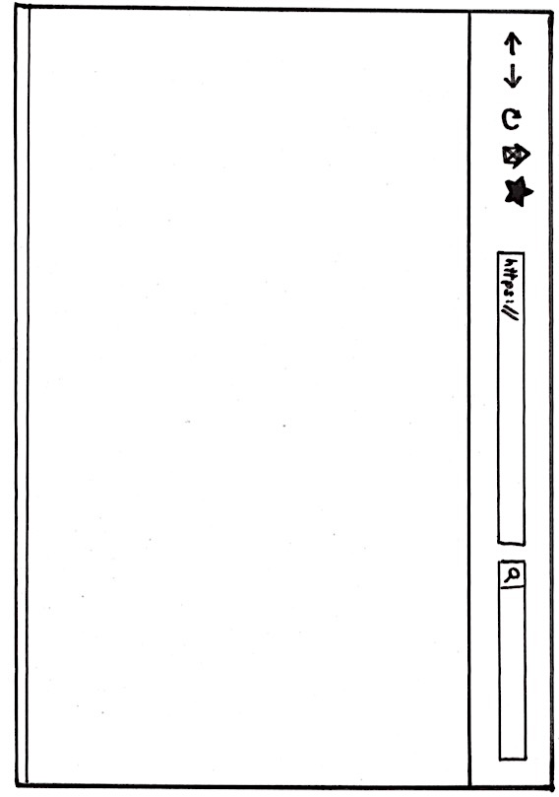

Slide 6




16:00
16:00
16:00
16:00

Slide 7
16:00
16:00
16:00
16:00

Slide 8


Slide 10



Slide 12


Slide 14











Slide 15






Slide 16

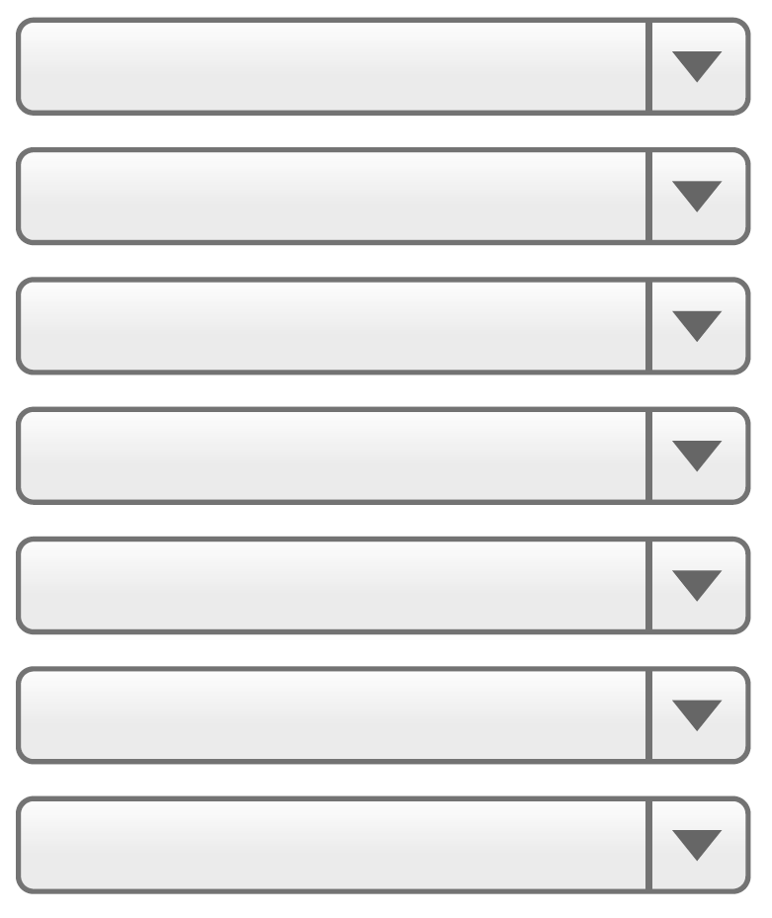
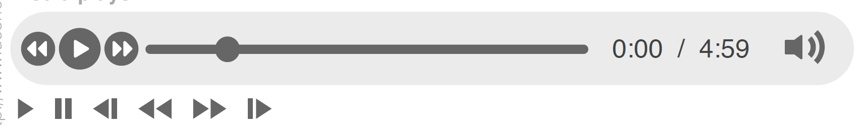
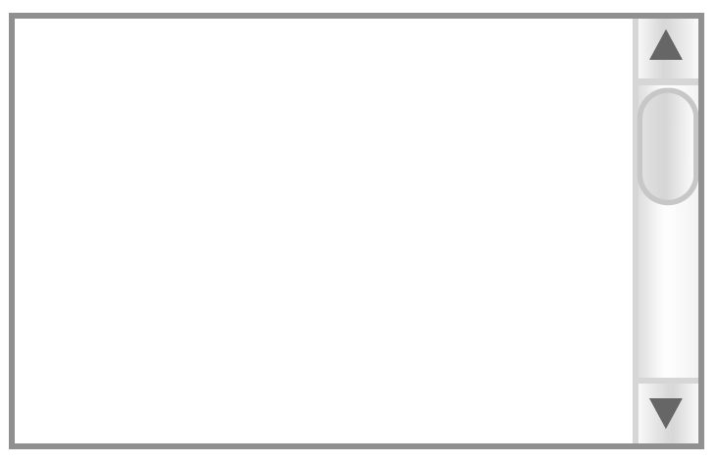
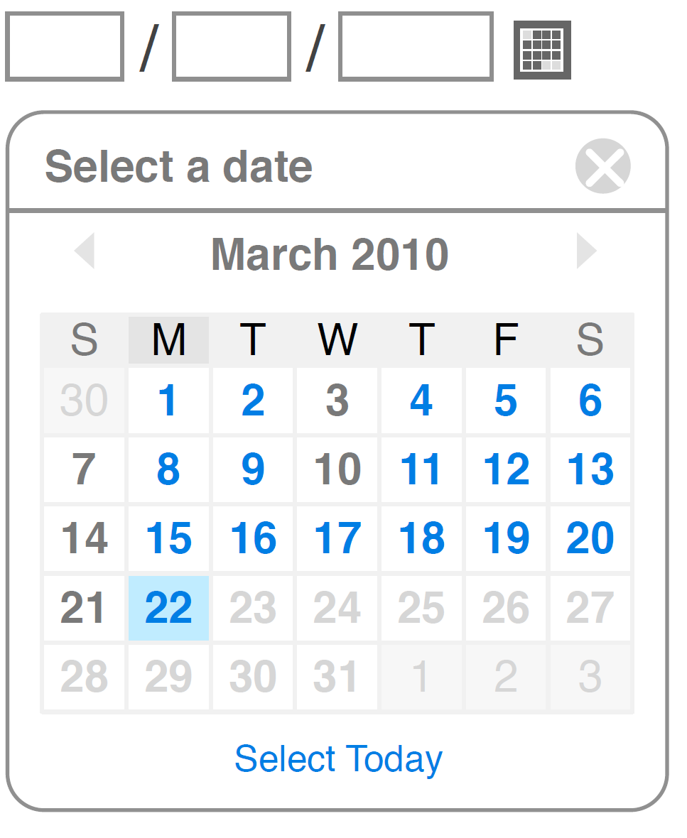

Slide 17
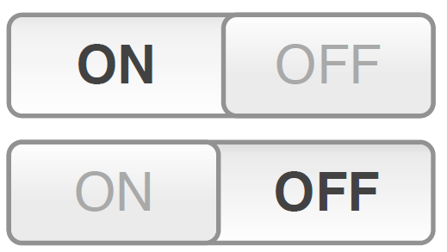
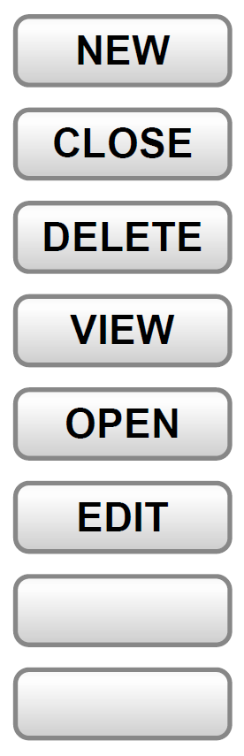



Slide 18










Slide 19











Slide 20
